Slide 1

Rajhat, Bandel, Hooghly, West Bengal
Department of Computer Science Engineering
B-tech 4th Year 2022-23
Project on: Virtual Trial On Outfit
26900119004 Subrata Ghosh
26900120030 Vishal Choudhary
26900119016 Arnab Gayen
26900119002 Aparna Jha
26900120042 Puja Singh
Guided By -
Mr. Aditya Kumar Pathak

Slide 2
Introduction
Nowadays, people are purchasing most of their items online and are spending more on it especially in fashion items since browsing different styles and categories of clothes is easy with just a few mouse clicks. Despite the convenience that online shopping provides, customers tend to concern about how a particular fashion item image on the website would fit with themselves. Therefore, there is an urgent demand to provide a quick and simple solution for virtual try-on. With the recent progress in virtual try-on technologies, people can have a better online shopping experience by accurately envisioning themselves wearing the clothes from online categories. Furthermore, virtual try-on technologies not only have demand in online shopping but also in physical shopping. In other words, with the try-on technologies developed on mobile application, customers can save their time of going into the fitting room.

Slide 3
Continued…
The intent of our project is that the users should be able to take virtual experience of Dressing by using Artificial Intelligence and optimizing the cost and time required for Trying cloth.
Our application will be a simple web based application that will be user friendly.
The principle of the application is started with uploading picture of user as Model and Targeted Clothes and our model will do Pose Detection , Clothes masking and then finally gives Output as Model with Targeted Clothes.
Objective
To give virtual view of targeted cloth.
To get instant view of clothes on ourselves.
To reduce time and effort required for trying dresses.

Slide 4
Methodology
Person representation and shop clothes are wrapped by using OpenCV libraries of Python. OpenCV-Python is a library of Python bindings designed to solve computer vision problems.
Creating the webpage using CSS and html.
Selecting the Clothes of user choice.
Output is seen on the screen of selected material.
A application with user interface is developed to test practically the performance. The user interface allows the user to choose a dress and fashion kit.

Slide 5
Implementation Methodology
Person representation and shop clothes are wrapped by using Open CV libraries of Python. OpenCV-Python is a library of Python bindings designed to solve computer vision problems.
Creating the webpage using CSS and HTML.
Selecting the Clothes of user choice.
Output is seen on the screen of selected material.
An application with user interface is developed to test practically the performance. The user interface allows the user to choose a dress and fashion kit.

Slide 6





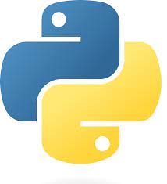
Technology Used
Front End:
HTML
CSS
Bootstrap
Java Script
Back End:
Python
Libraries:
Open CV
NumPy
Flask
IDE:
VS Code

Slide 7
Total Modules
Dataset Gathering and Pre-Processing
Model Training
Input person pose and shop cloth
Concatenation of Clothes and Pose
Finally get the output weared cloth person
GUI Design and Deployment

Slide 8
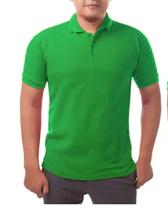
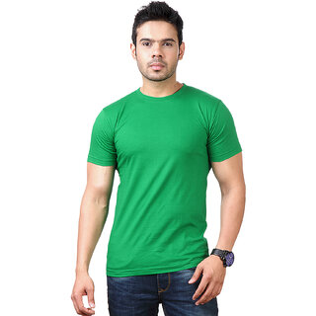
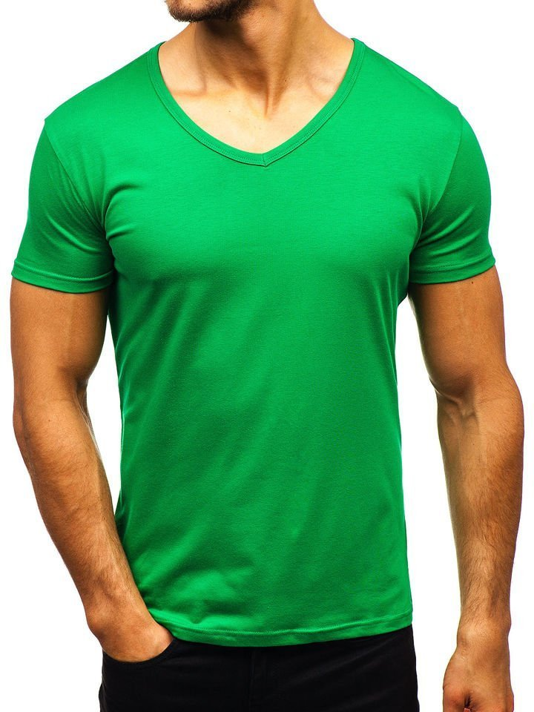

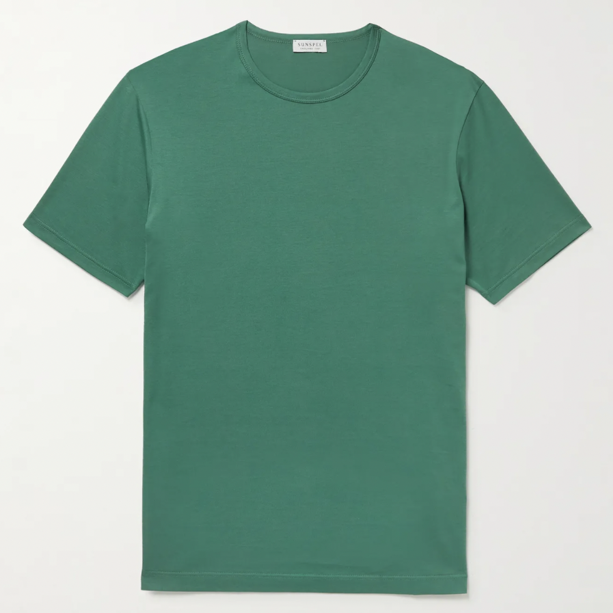
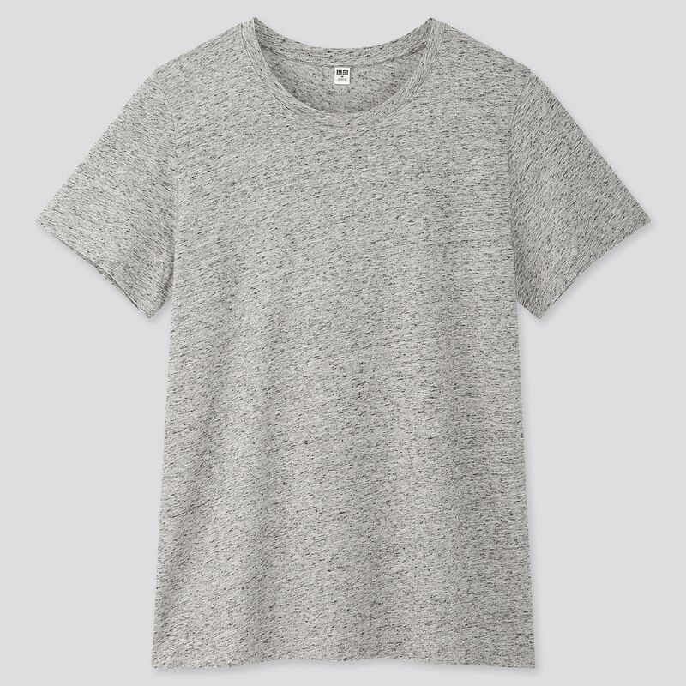
Dataset Used
Person Representation:
In-shop clothes:

Slide 9
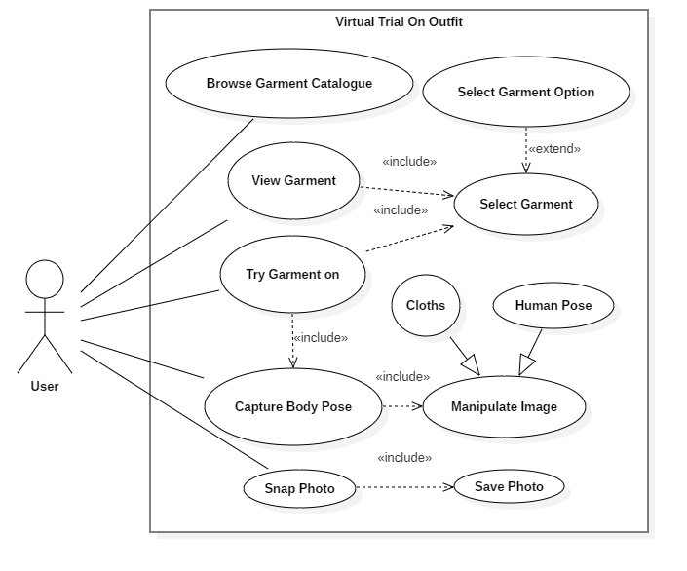
SYSTEM DESIGN
Use case Diagram

Slide 10
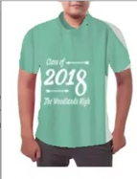
Block Diagram
Person Representation
Wrapped Clothes
Cloth on person
In-Shop Clothes

Slide 11
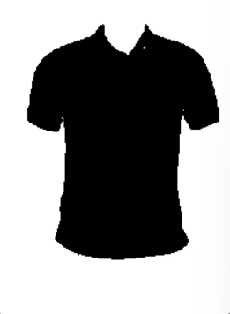
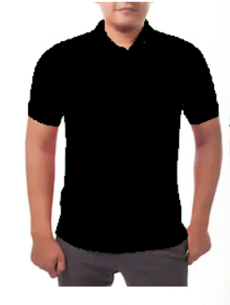
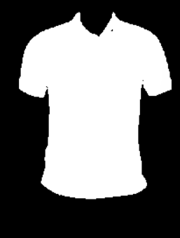
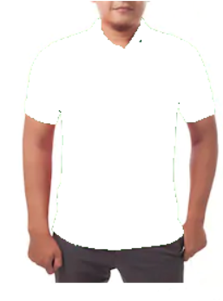
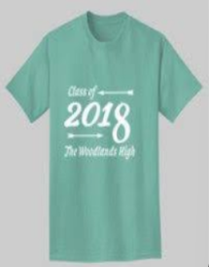
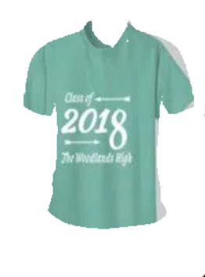
Image Processing
Person Representation
Wrapped Clothes
Cloth on person
In-Shop Clothes

Slide 12
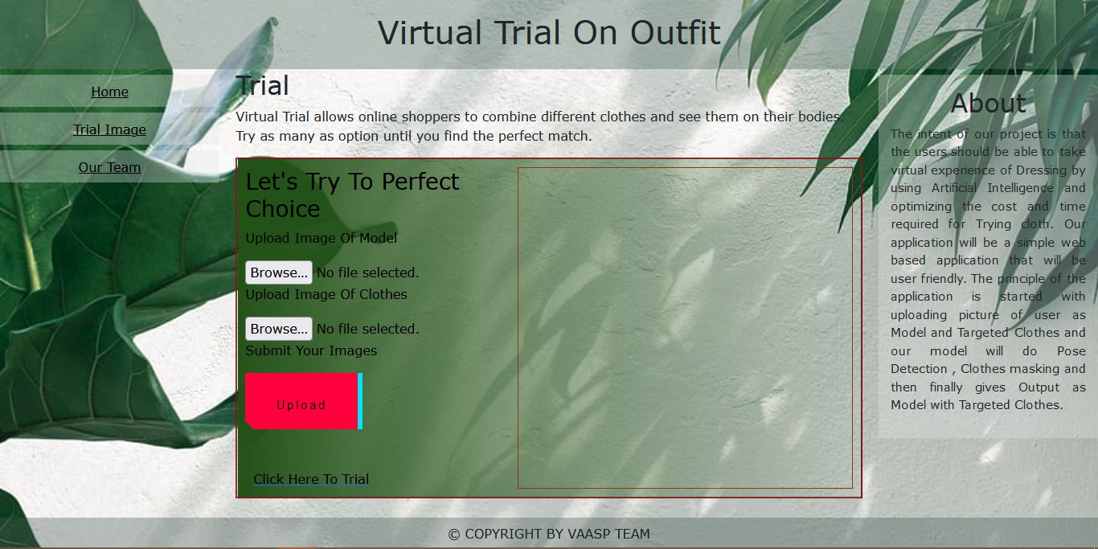
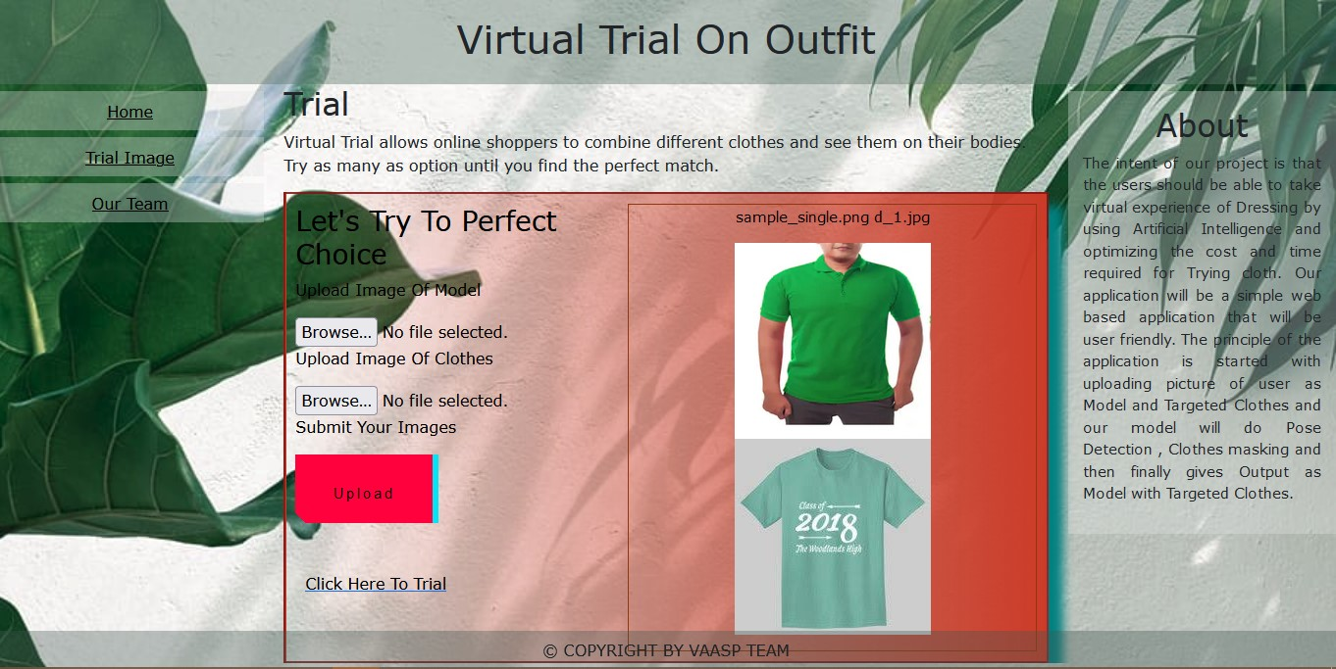
GUI Design
Home Page: Uploaded Page:

Slide 13
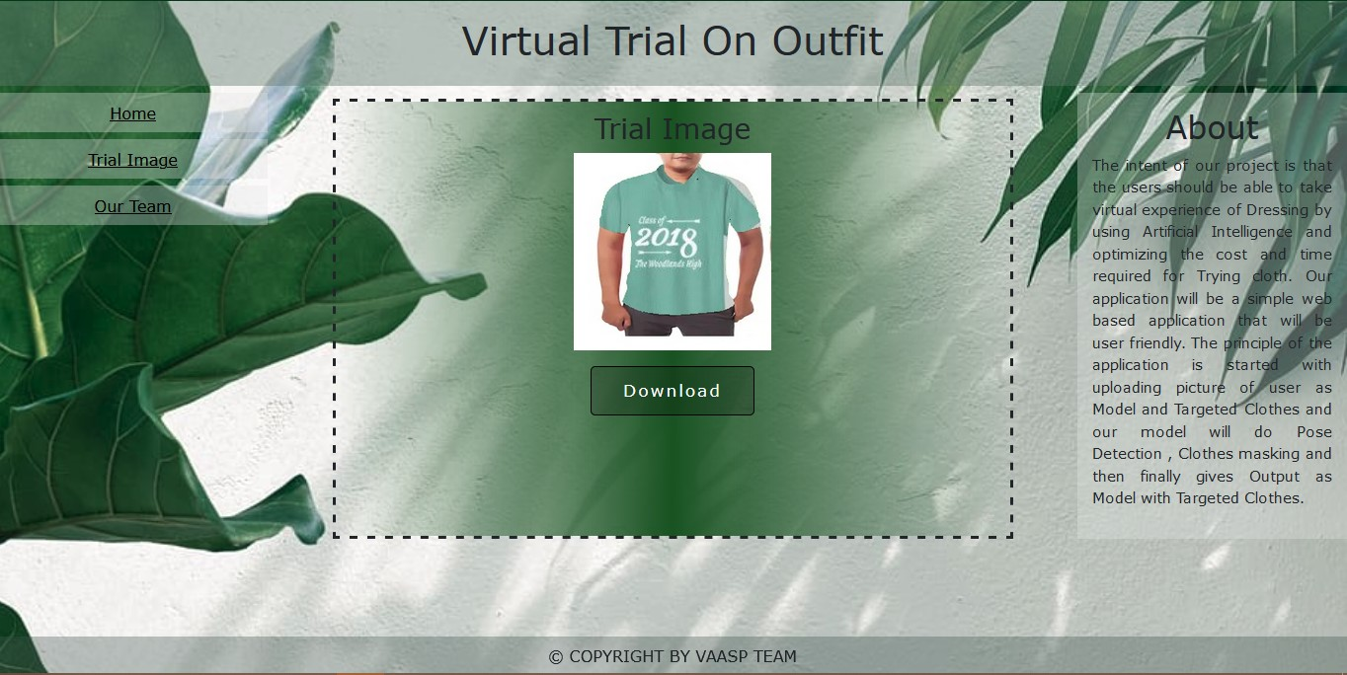
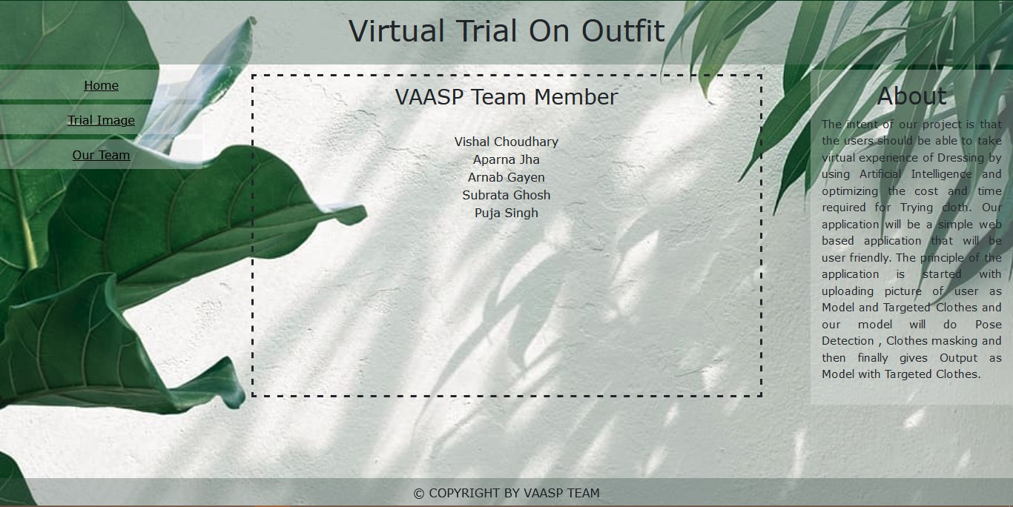
Trial Image: About Page:

Slide 14
Future Scope
This application can be easily implemented in various situations. We can add new features as and when we require them. There is flexibility in all the modules.
This Project works currently for clothes. The Project can be improvised to include fashionable product (like watch, eye glasses etc.) also.
This project can be improvised by including an automatic size recommendation feature for the user.
It is also providing a window of opportunity for AI-based innovations in the future. And there are already new approaches designed to solve those issues.
Another important thing is to take the technology capabilities into account when choosing a proper use case scenario.

Slide 15
Future Scope
5. We propose a novel fully automatic method to redress 3D wearable items including garments, shoes, eyeglasses, necklaces, hats, watches and even hair, from are faïence body mesh to a target body mesh.
6. To our best knowledge, this is the first generic method of wearable items virtual try-on.
7. We proposed novel pipeline of automatically deforming a template body mesh to fit to a target body mesh.
8. The extensive experiments show that the proposed method can be used to redress varying wearable items. The geometry of redress edit elms depends on the shape and posture of the target body. The main limitation of our current work is that it fails on dresses. This is because our fit representation cannot assign a vertex of garment to two legs, which results in cloth tear. Future work will address this issue.

Slide 16
Conclusion
“Virtual trial on outfits” technology is going to help both the users and the brands as well. It can work in different sectors within the fashion industry. Its digital interaction design allows brands across the spectrum to reach out to a wider audience and engage them more effectively. As a result, they are getting closer to the future. A virtual trial system is designed for the purpose of a cloth changing room. Our motivation here is to increase the time efficiency and improve the accessibility of clothes try-on by creating a virtual trial dressing room environment.
We have presented a fully automatic method to redress 3D wearable items on to bodies with various shape sand poses. The proposed method can be useful to visualize the try-on appearance for customers and fast design a dressed character for computer animations and games. To our knowledge so far, it is the first generic virtual try-on method of wearable items.

